Slide 1



Employee Data Analysis using Excel
STUDENT NAME: ELAKIYAA.J.B
REGISTER NO: 312215819
DEPARTMENT: B.COM ACCOUNTING AND FINANCE
COLLEGE: SHRI SHANKARLAL SUNDARBAI SHASHUN JAIN COLLEGE FOR WOMEN

Slide 2
PROJECT TITLE
EMPLOYEE PERFORMANCE ANALYSIS USING EXCEL………

Slide 3
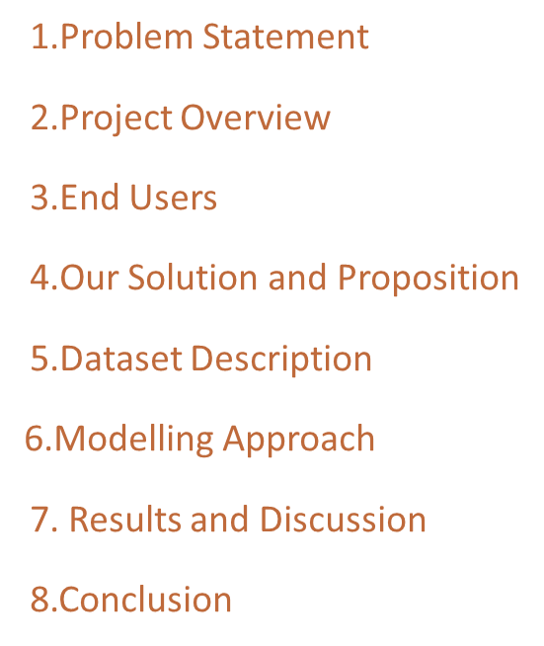
AGENDA

Slide 4
PROBLEM STATEMENT
"As the HR Manager of a mid-sized organization, I need to analyze the performance of 500 employees across various departments and roles. The current manual process of tracking performance metrics, such as sales targets, task completion rates, and training participation, is time-consuming and prone to errors.

Slide 5
PROJECT REVIEW
This project review provides a comprehensive overview of the Employee Performance Analysis on Excel, covering objectives, scope, deliverables, evaluation criteria, timeline, resources, risks, benefits, lessons learned, and future enhancements.
Rating Scale:-
1 (Needs Improvement)
2 (Meets Expectations)
3(Exceeds Expectations)
Project Rating: 2.5 (Exceeds Expectations in some areas, Meets Expectations overall)
Recommendations:
Continue to refine and expand the dashboard.
2. Develop a training program for users.
3. Monitor and address data quality issues.

Slide 6
OUR SOLUTION AND PROPOSITION
ExcelPerformancePro is a comprehensive Excel-based solution for employee performance analysis. Our intuitive dashboard empowers HR managers, department heads, and supervisors to:
Automate data collection from multiple sources.
2. Track key performance indicators (KPIs) in real-time.
3. Identify trends, strengths, and areas for improvement.
4. Make data-driven decisions.

Slide 7
END USERS
Primary End Users:
HR Manager
Department Heads
Supervisors/Team Leads
Secondary End Users:
Employees
Talent Development Team
Compensation and Benefits Team
Executive Stakeholders:
CEO/President
CFO
Board of Directors

Slide 8
DATASET DESCRIPTION
Employee data set taken from the KAGGLE
In dataset, out of 26 data I took only 9 features out of it.
The selected 10 features are listed below:
1. Employee ID 6. Employee status
2. First name 7. Employee classification type
3. Last name 8. Gender code
4. Business unit 9. Performance code
5. Employee Type 10. Current employee rating

Slide 9
MODELLING
1) DATA COLLECTION
The data has been collected through Edunet dash board.
2) FEATURE COLLECTION
The listed 10 features were taken for the analyses of data
3) DATA CLEANING
Identifying the missing values.
Filtering of those missing values
4) CALCULATION OF PERFORMANCE LEVEL
By considering the current eroployee rating, I found the performance level using the formula.

Slide 10
MODELLING
5) SUMMARY OF PIVOT LEVEL
Segregating od certain features to rows, columns, heading and so on.
6) SIVISUALIZATION
Once completed with pivot table, created the graph for precise visualization

Slide 11
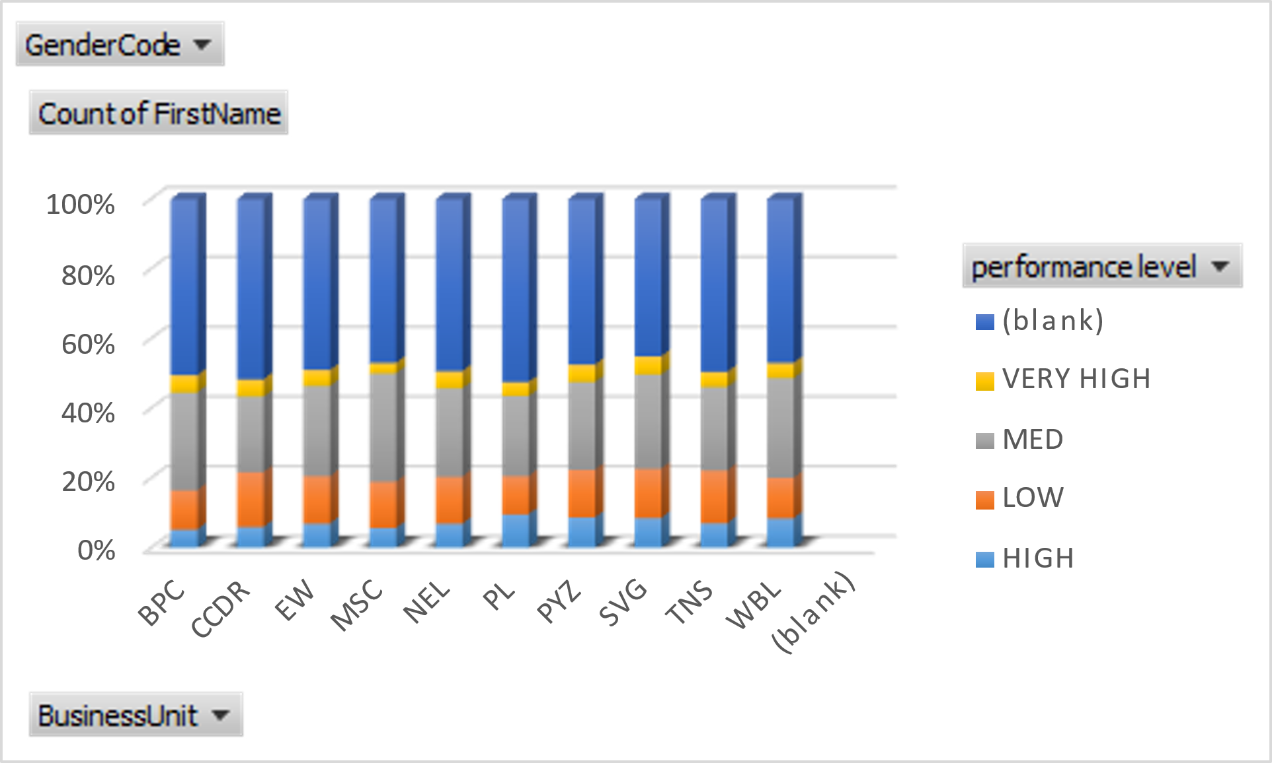

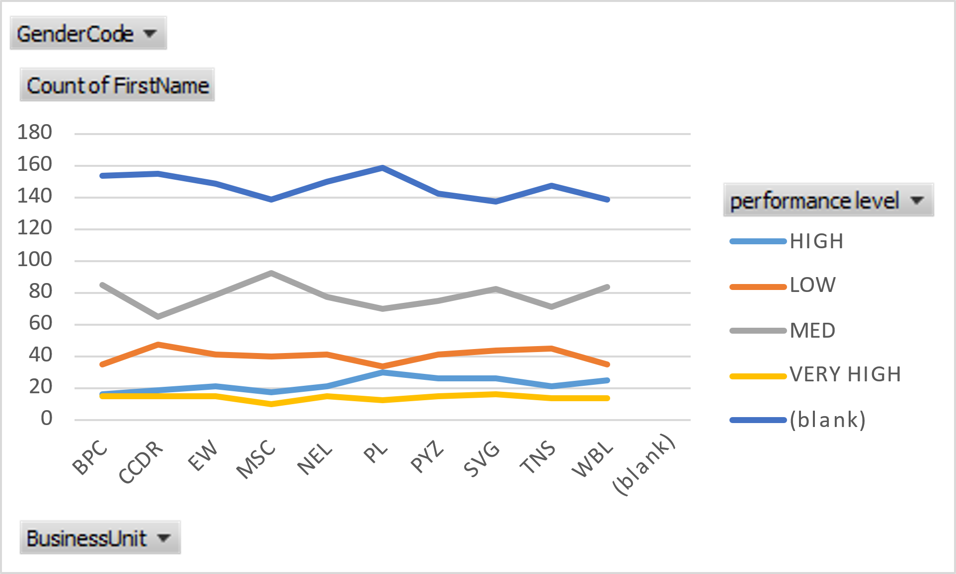
RESULTS

Slide 12
CONCLUSION
Employee Performance Analysis on Excel is a powerful tool for organizations to measure, track, and improve employee performance. By leveraging Excel's capabilities, HR managers and department heads can:
Automate data collection and analysis
2. Identify trends and areas for improvement
3. Make data-driven decisions
4. Enhance employee engagement and productivity
5. Improve talent retention and development

